Slide 1
Lecture 3
Introduction to OpAmp

Slide 2
Review
Last class: alternative representation, KCL, KVL, nodal
Today: review of dependent source, introduction to amplifiers, operational amplifiers

Slide 3
Dependent Source
Active sources – either voltage of current source
Difference: voltage (or current) controlled by the voltage/current in a different branch
Technically non-linear devices – because in real life, dependent sources are made using non-linear electronic devices (e.g. MOSFET)
However, analysis are similar to linear circuits (CSE250), hence we will start with this

Slide 4
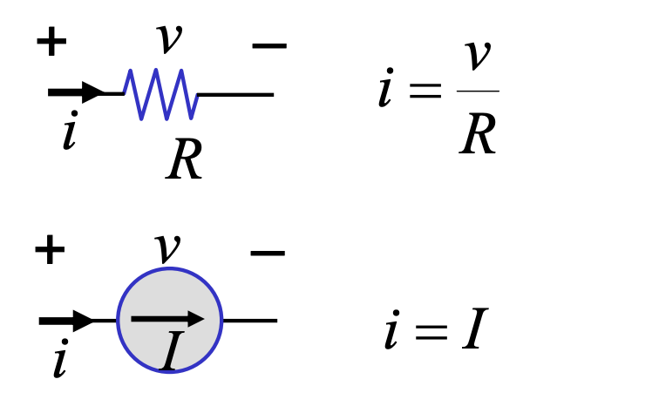
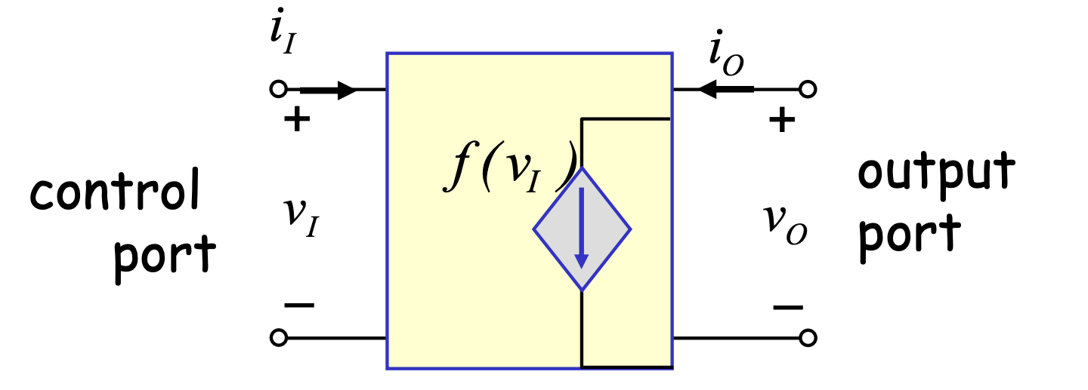
Major Difference
Independent devices:
Dependent devices:
2 terminals, 1 port
2 terminals, 2 port

Slide 5
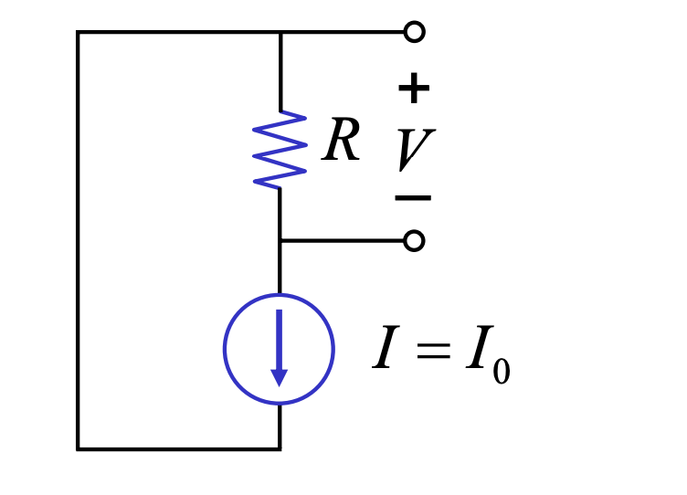
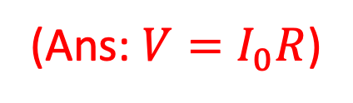
Example 1
Find V

Slide 6
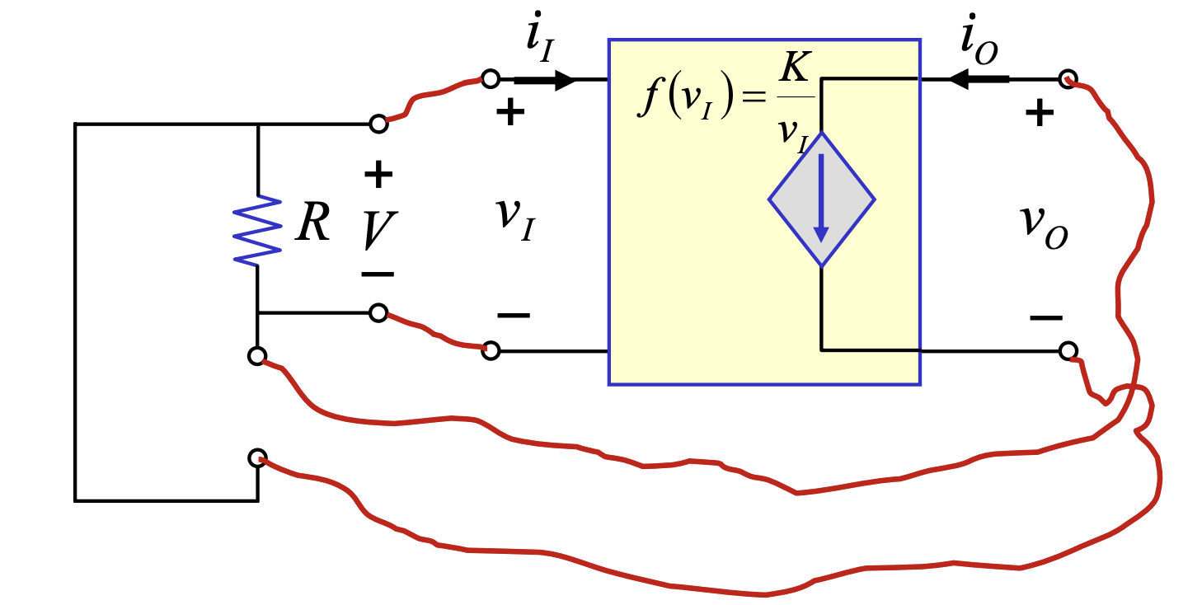
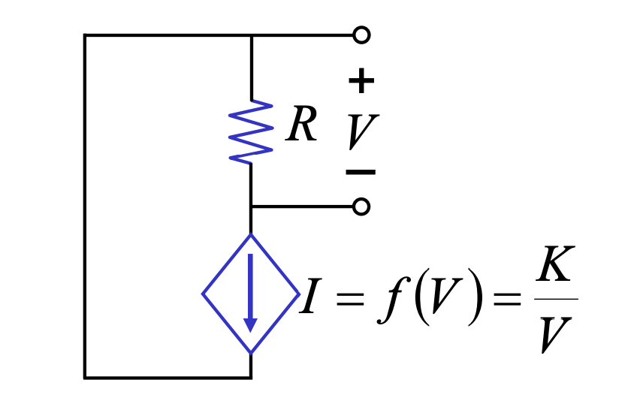
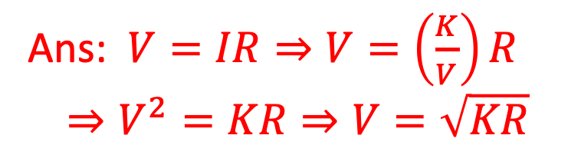
Example 2
Find V
Application of dependent sources: amplifiers!

Slide 7
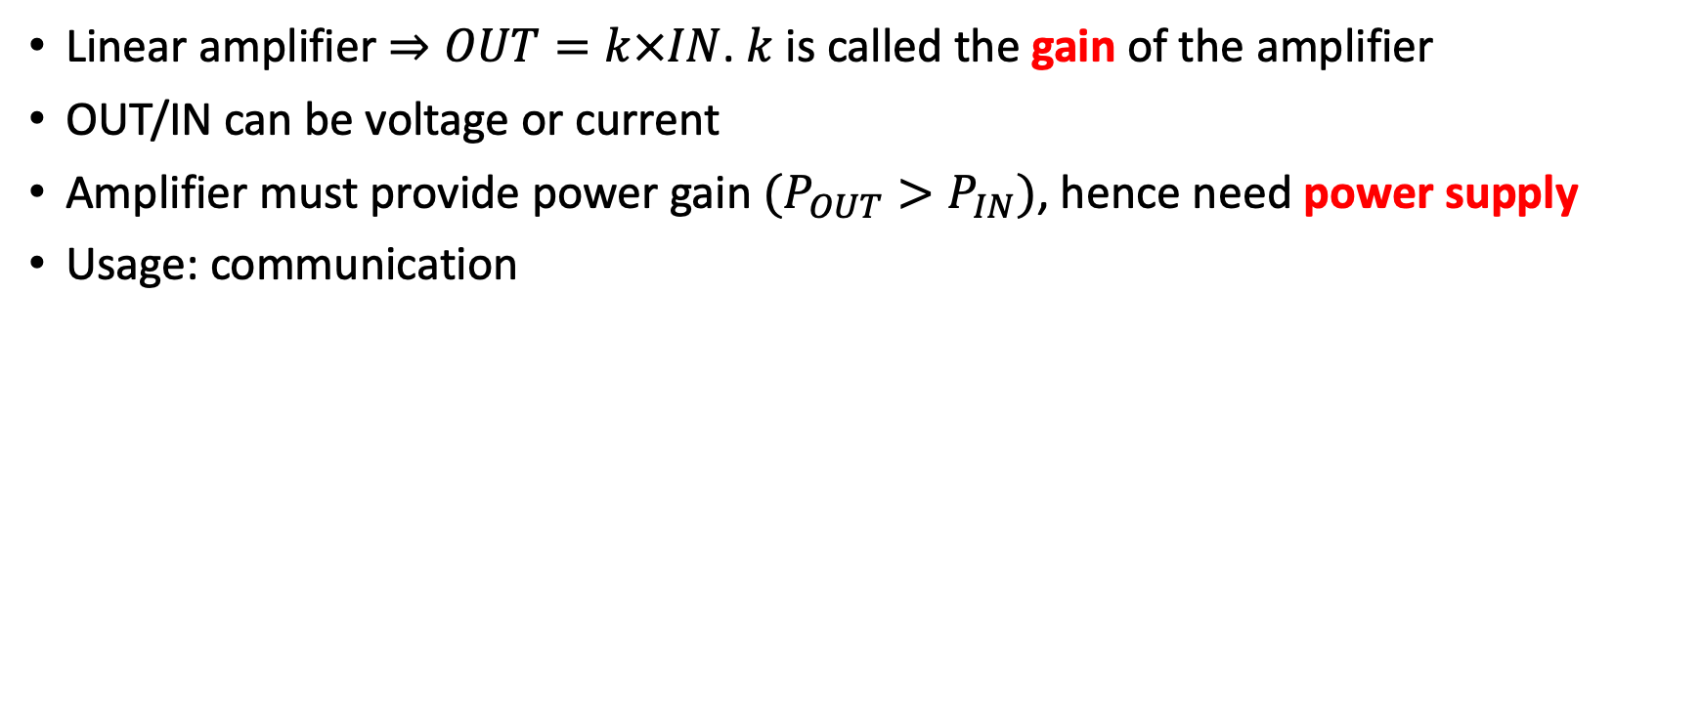
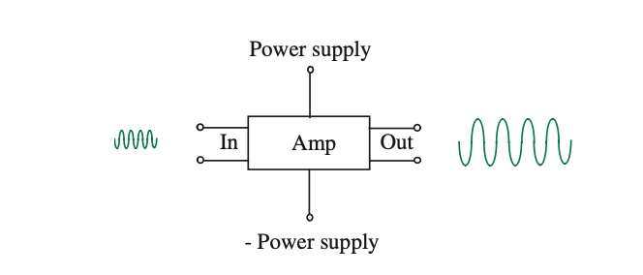
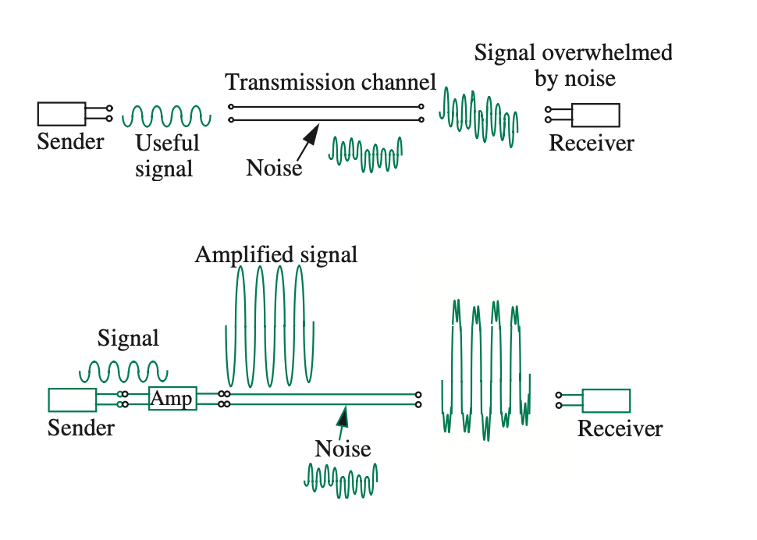
Amplifier

Slide 8
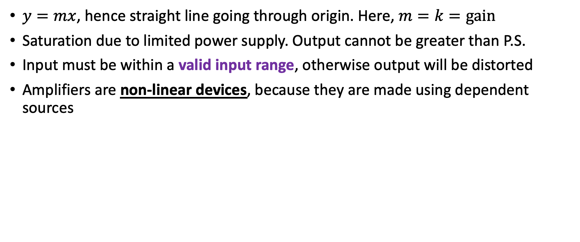
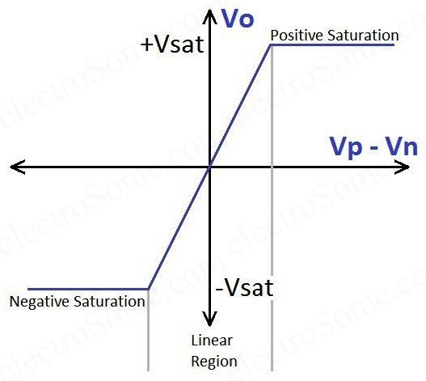
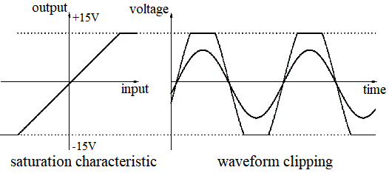
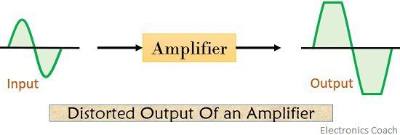
Transfer Characteristics of Amplifiers
OUT
IN

Slide 9
Operational Amplifiers
An operational amplifier, or op-amp for short, is a versatile and powerful integrated circuit that is widely used in a variety of electronic applications.
An Op-Amp is designed so that it performs some mathematical operations when external components, such as resistors and capacitors, are connected to its terminals.
The op amp is an electronic device consisting of a complex arrangement of resistors, transistors, capacitors, and diodes. A full discussion of what is inside the op amp is beyond the scope of this course. For now, it will suffice to treat the op amp as a circuit building block and simply study what takes place at its terminals.

Slide 10
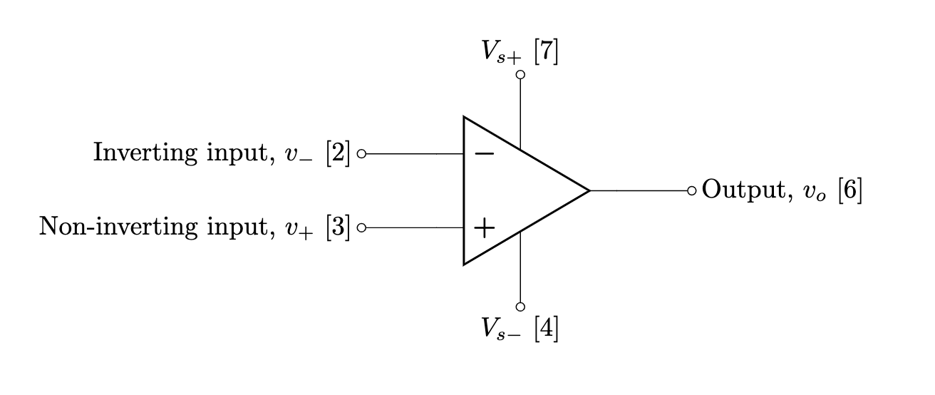
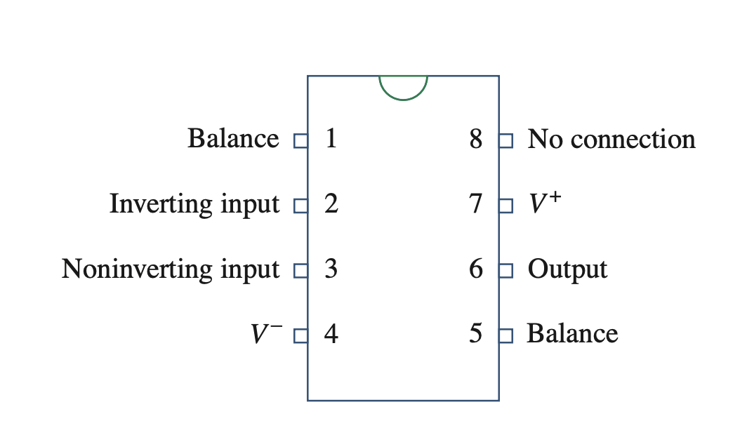
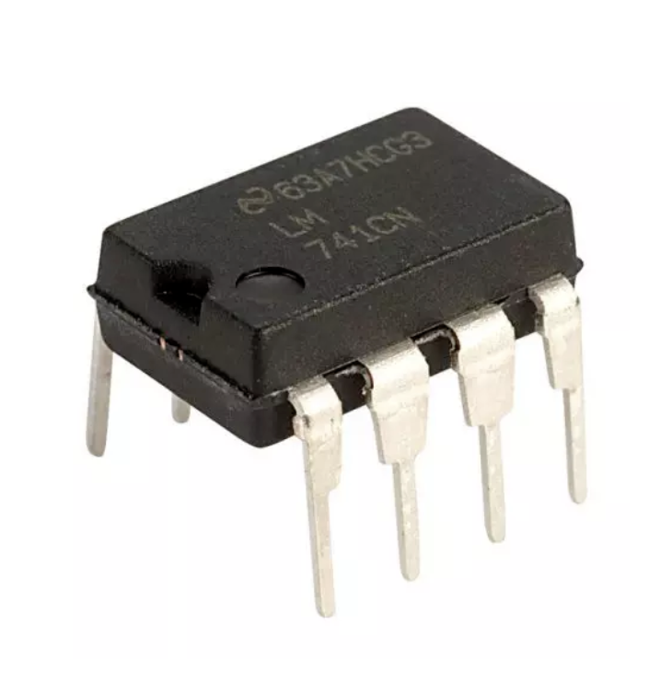
Terminals and Circuit Symbol
Op-amps are differential amplifiers – meaning it amplifies the voltage difference between two terminals. Therefore, it has two inputs
Since this is an amplifier, there are two terminals for power supply

Slide 11

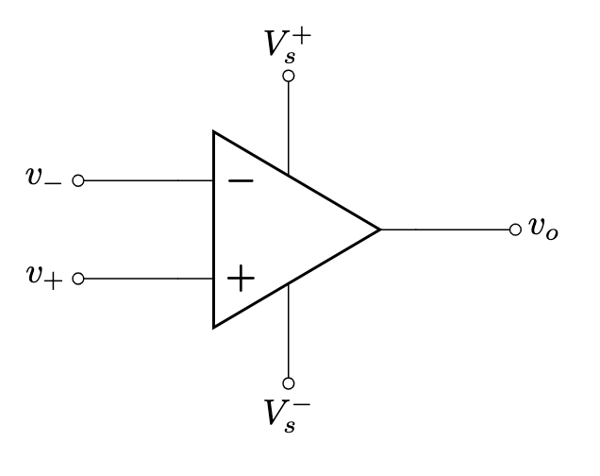
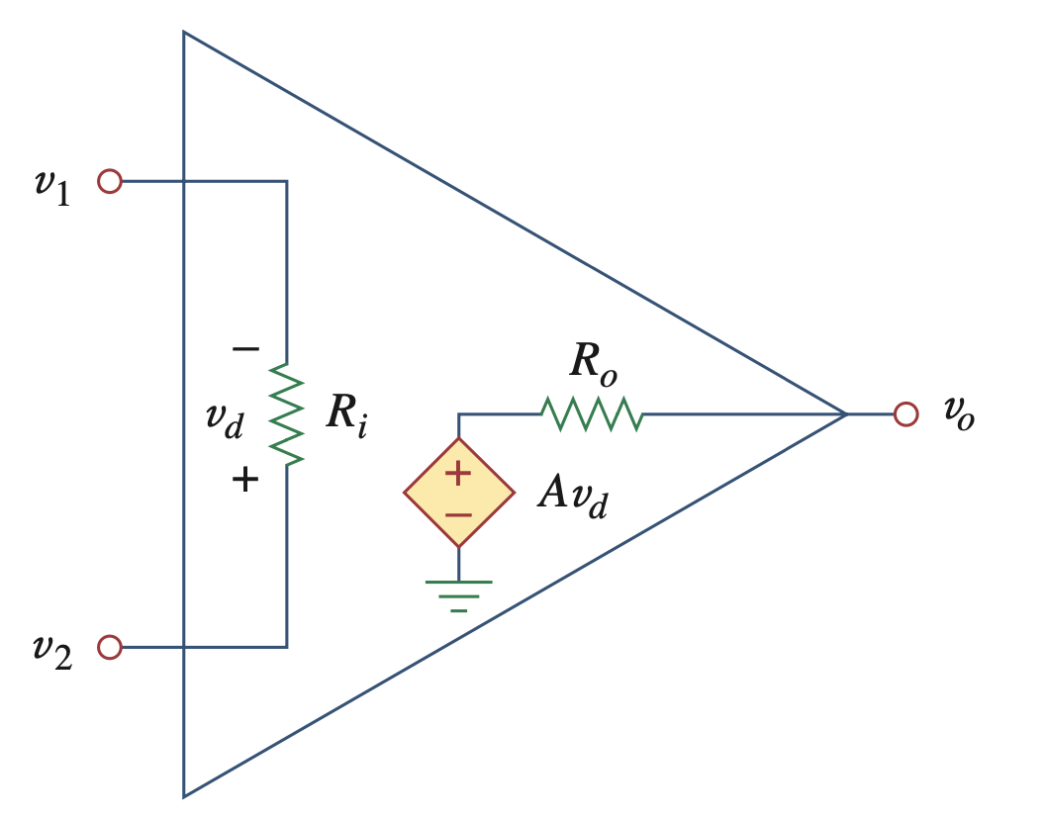
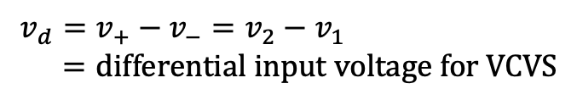



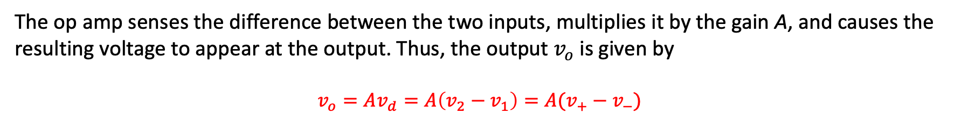
Equivalent Circuit
Since op amp is an amplifier, the internal circuit can be modeled using a voltage controlled voltage source (VCVS)! (actual circuit is complicated)

Slide 12

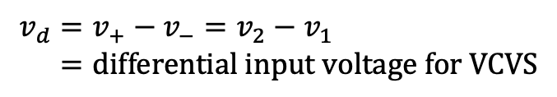

Equivalent Circuit
Since op amp is an amplifier, the internal circuit can be modeled using a voltage controlled voltage source (VCVS)! (actual circuit is complicated)
Parameter | Typical Range

Slide 13
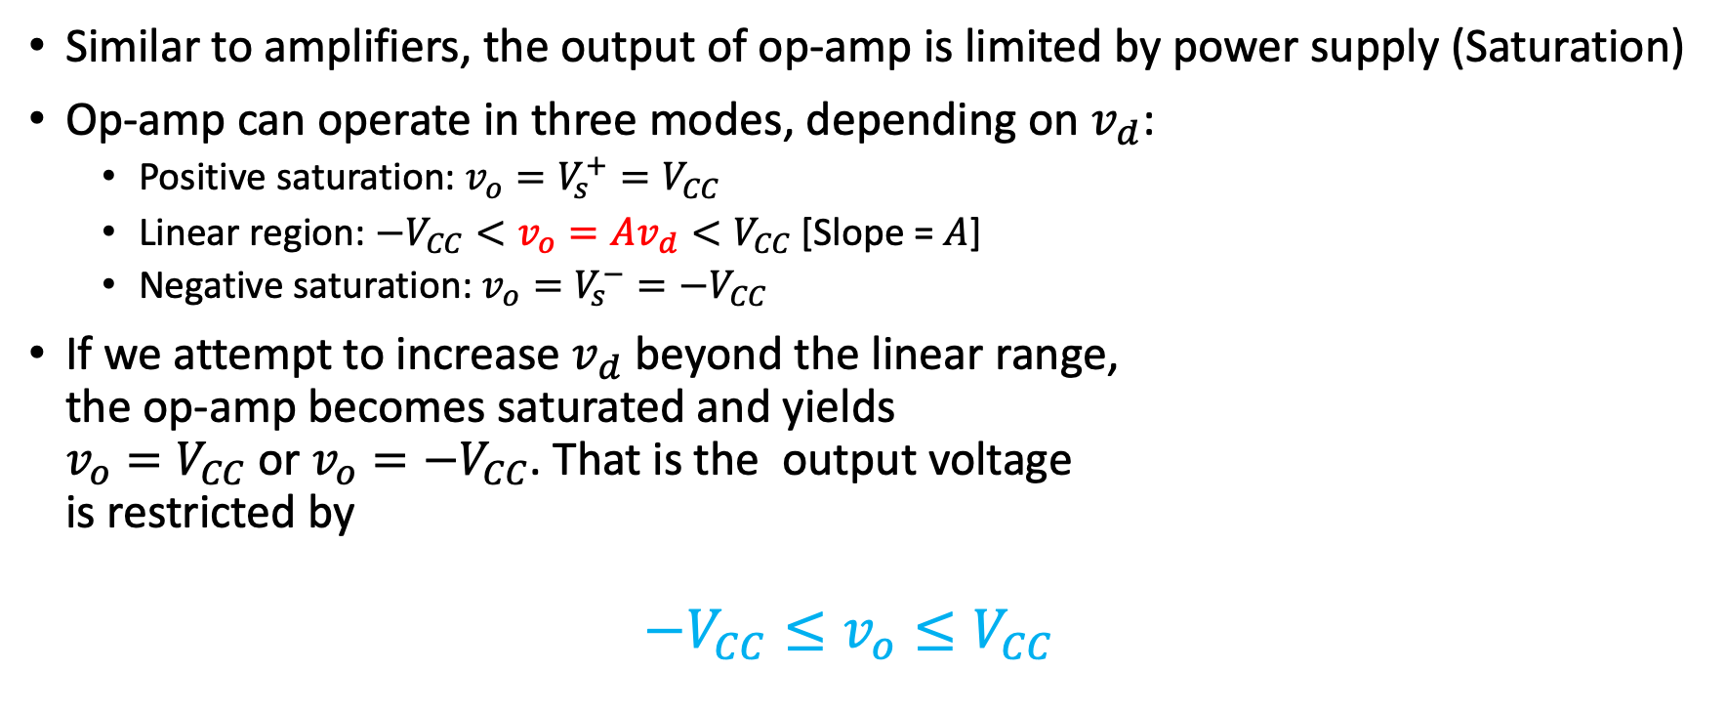
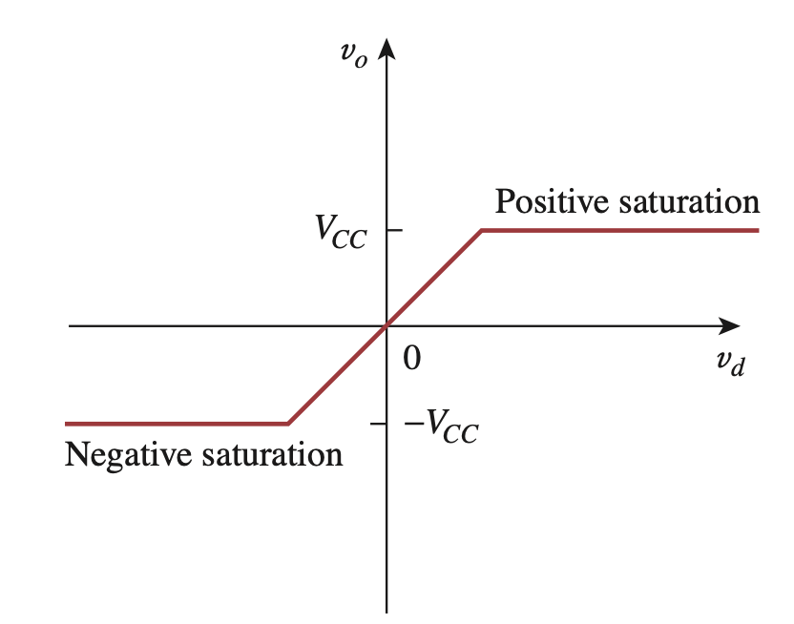
Practical Limitation - Saturation

Slide 14

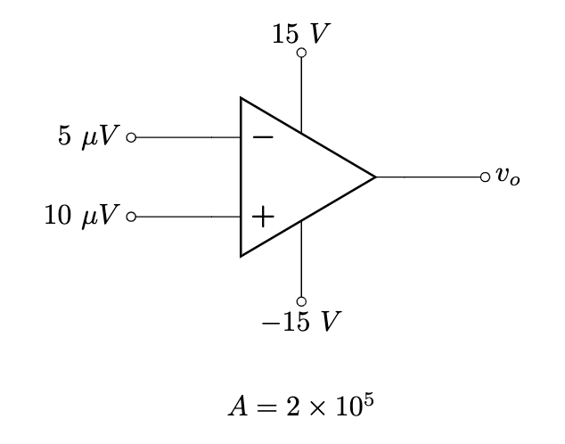
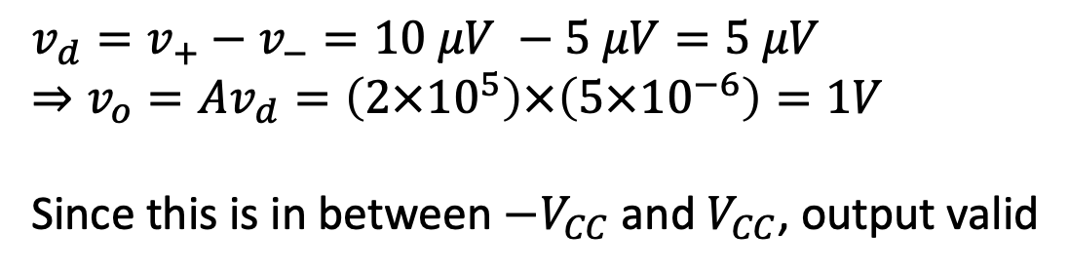
Example 3
Solution:

Slide 15
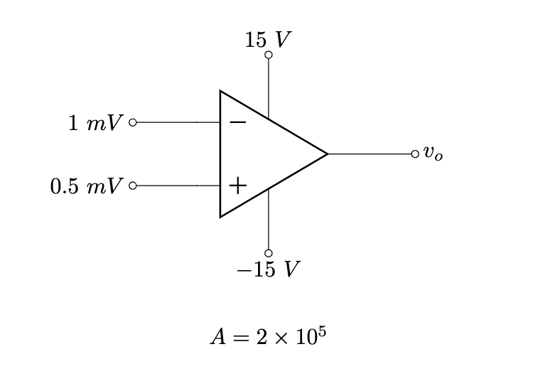
Example 4
Solution:
v_{d} = v⁺-v⁻ = 0.5 mV - 1 mV = -0.5 mV
➙ v_{o} = Av_{d} = (2x10⁵)x(-0.5x10⁻³) = -100V
However, the output must be limited within the range of -V_{CC} to +V_{CC}. Therefore, the highest output voltage can be -15V.
∴ v_{o} = -15V

Slide 16
Solving Circuit with Op-Amp
Don’t be scared! Circuit solving with op-amp is exactly same as the circuits you solved in CSE250
Step 1: replace with equivalent circuit
Step 2: solve using KCL & KVL, or nodal analysis (linear)
In most cases, the power supply voltages are not mentioned. Hence, we will assume the output is within the linear range in this case

Slide 17
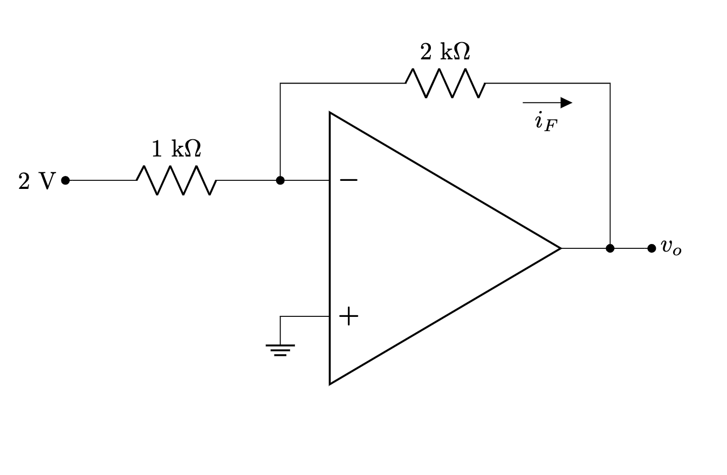
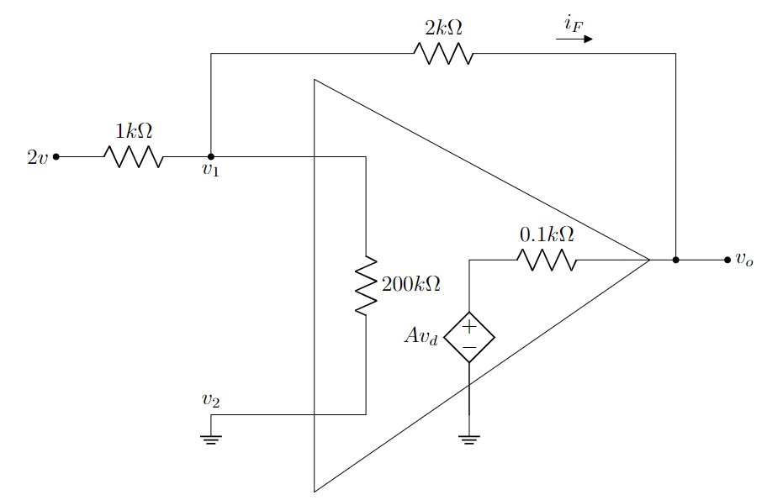
Example 5
Solution: Step 1: replace using equivalent circuit

Slide 18
Example 5
Applying KCL we get,
i₁= i₂+ i_{F}
➙ (2-v₁)/(1k) = (v₁-v₂)/(200k)+(v₁-v_{o})/(2k)
➙ (2-v₁)/(1k) = (v₁-0)/(200k)+(v₁-v_{o})/(2k)
➙ (2-v₁)/(1k) = v₁/(200k)+(v₁-v_{o})/(2k)........(i)
Step 2: Solve using KCL & KVL or nodal
Again, from the figure,
i_{0.1k} = i_{F}
➙ (v_{o}- Av_{d})/(0.1k) = (v₁-v_{o})/(2k)
➙ (v_{o}- (2x10⁵)x(v₂-v₁))/(0.1k) = (v₁-v_{o})/(2k)
➙ (v_{o}- (2x10⁵)x(0-v₁))/(0.1k) = (v₁-v_{o})/(2k)
➙ (v_{o}- (2x10⁵)x(-v₁))/(0.1k) = (v₁-v_{o})/(2k)...(ii)
i₁
i₂
We can get v₁ and v_{o} by solving equation (i) and (ii)

Slide 19
Example 5
Step 2: Solve using KCL & KVL or nodal

Slide 20
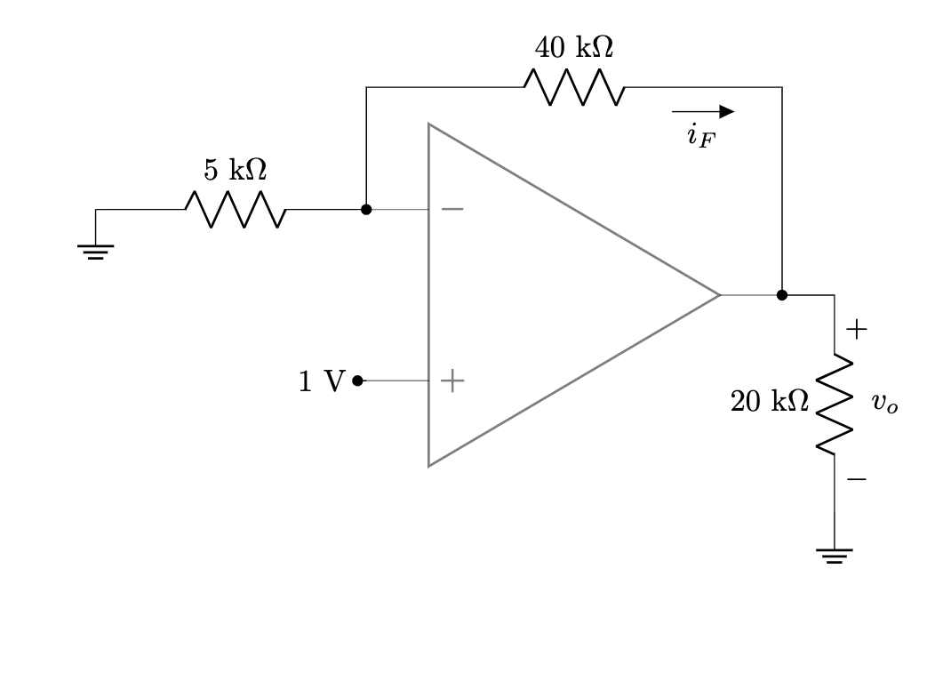
Example 6

Slide 21
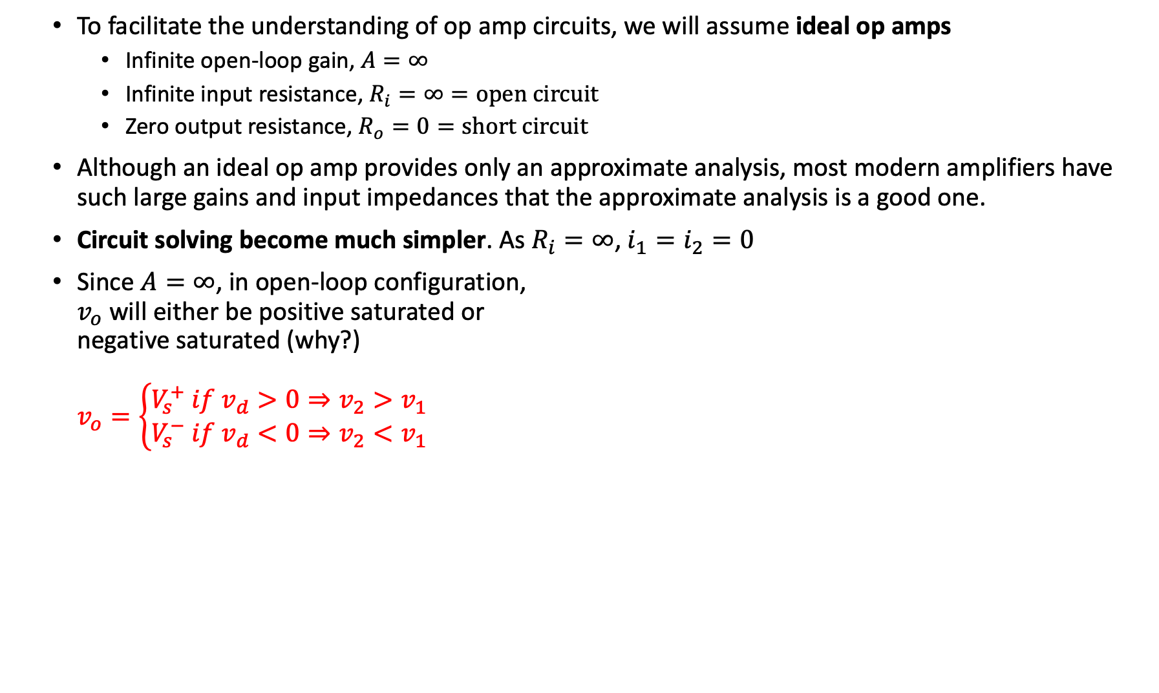

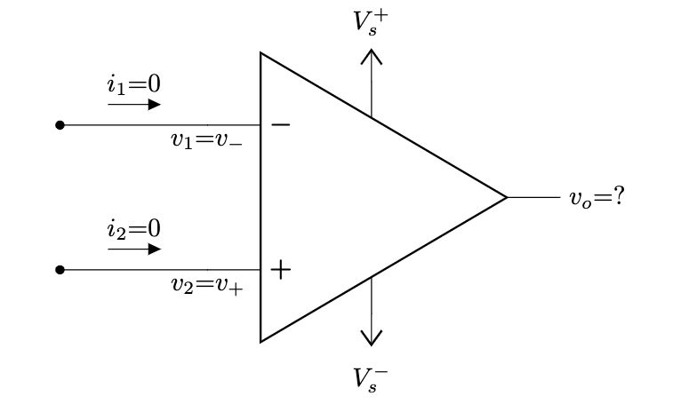




The Ideal Op-Amp
VTC of ideal op amp

Slide 22
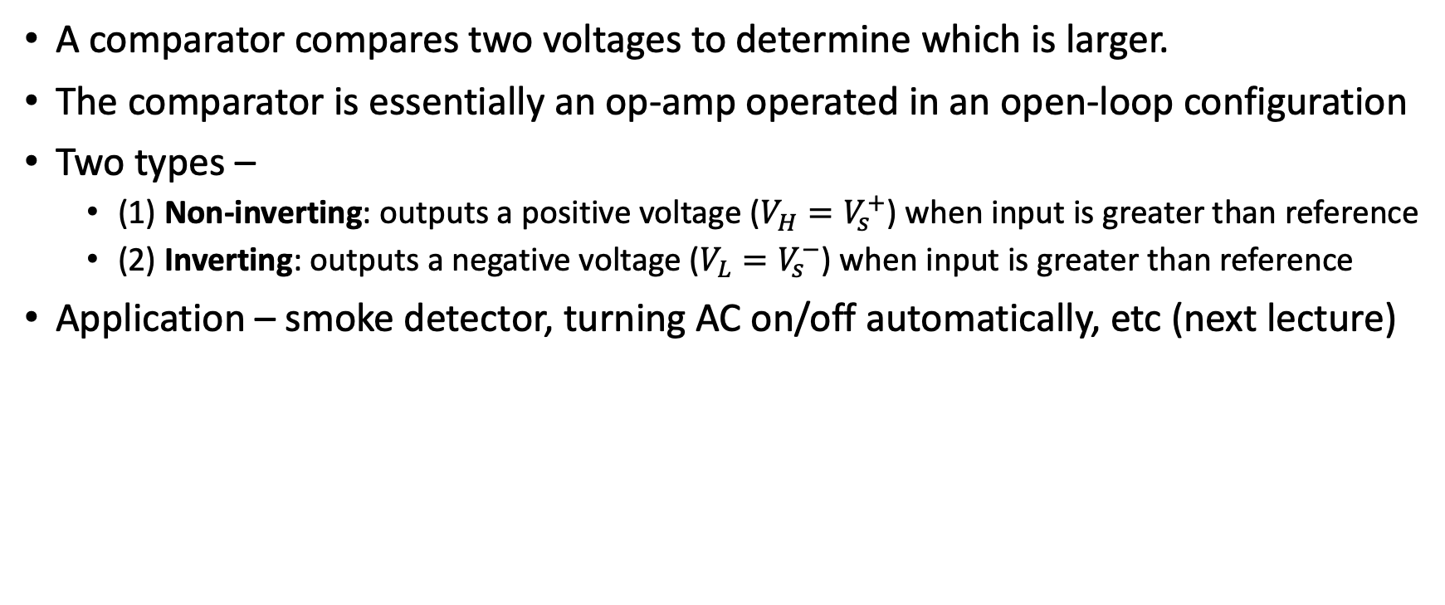
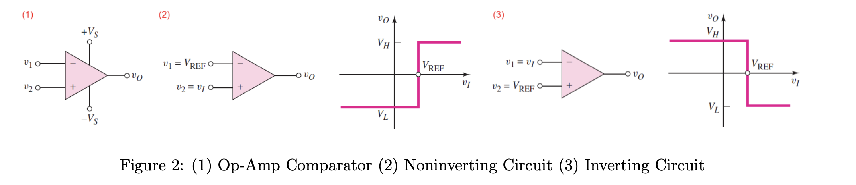
Application - Comparator

